Slide 1
Lecture 5
Preparing Data sources

Slide 2
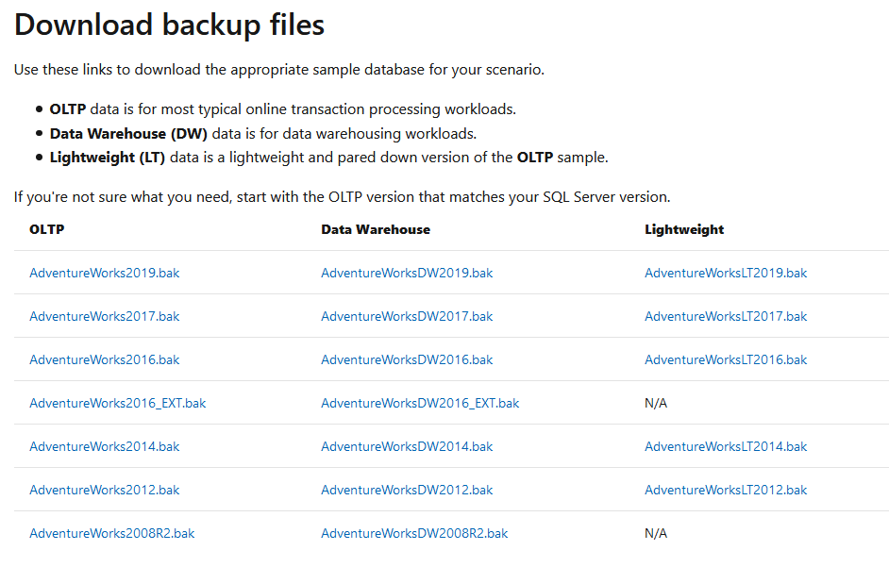
Adventure works database
We need a sample database to build a data warehouse
Download one of this backup files

Slide 3
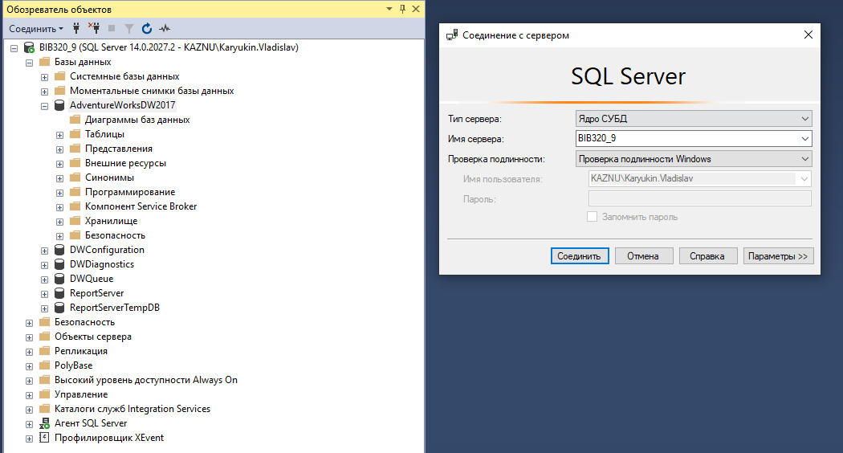
Database connection
In SQL Server Management Studio connect to the server
Restore Adventure works database from the backup

Slide 4
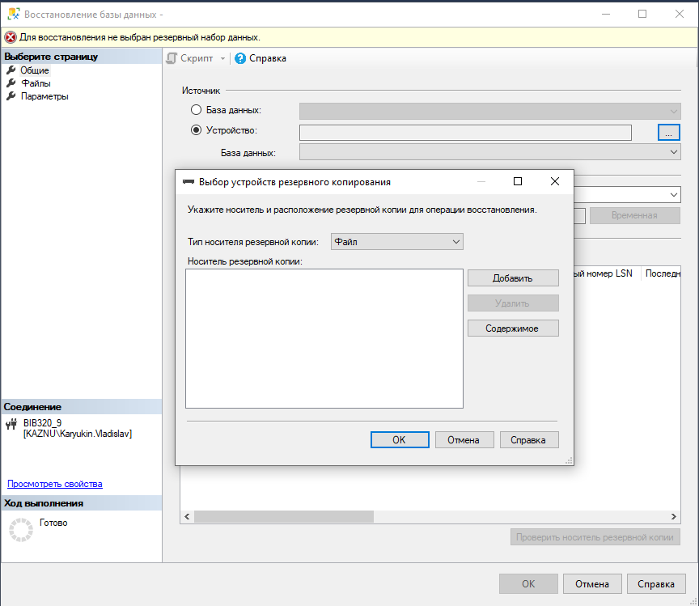
Database backup
Right click on the database icon and choose “restore” option
Navigate to the location where a backup file is situated

Slide 5
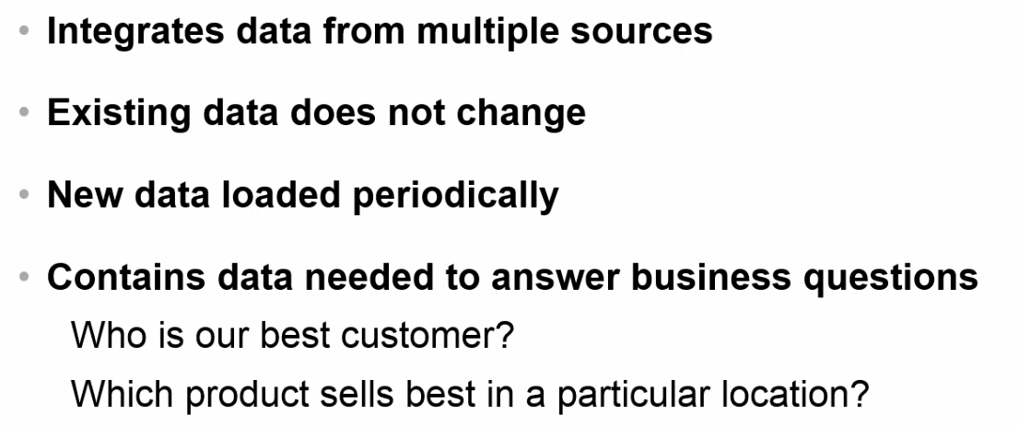
DATA ware house

Slide 6
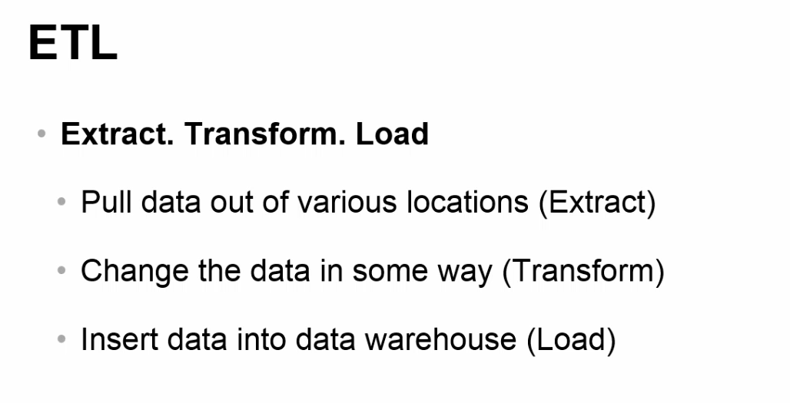
ETL process

